Slide 1
Health Care for Patients with NF

Slide 2
General
Survey name
Health Care for Patients with NF
Author
Tumour Foundation of BC
Survey language
en
Survey URL
https://www.survio.com/survey/d/F1E4X4H9J5V4B0A4H
First response Last response
06/10/2020 07/16/2020
Duration
37 days

Slide 3
Survey visits
134
52
0
74
38.8%
Total visits
Total completed
Total unfinished
Displayed only
Overall completion rate
Visit History (06/10/2020 - 07/16/2020)
Total visits (134)
Total completed (52)

Slide 4
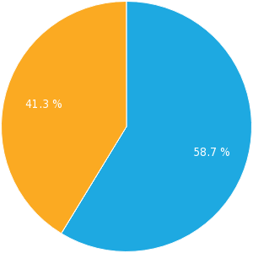
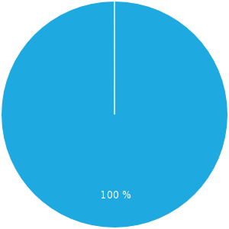
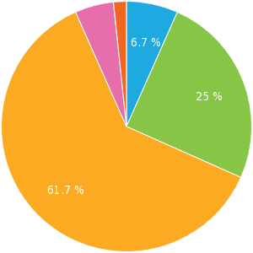
Total Hits
Visit Sources
Average Time of Completion
Displayed only (58.7 %) Unfinished (0 %) Completed (41.3 %)
Direct link (100 %)
2-5 min. (6.7 %) 5-10 min. (25 %) 10-30 min. (61.7 %) 30-60 min. (5 %) >60 min. (1.7 %)

Slide 5
Where do you currently live in BC? Please enter your postal code.
Text answer, answers 49x, unanswered 3x

Slide 6
How many people in your household have NF?
Text answer, answers 49x, unanswered 3x

Slide 7
What are the ages of each person in your household with NF?
Text answer, answers 49x, unanswered 3x

Slide 8
Are you completing this survey on behalf of another person?
Single choice, answers 49x, unanswered 3x
Answer Choices | Responses | Ratio
Yes | 23 | 46.94%
No | 26 | 53.06%

Slide 9
Are you completing this survey on behalf of:
Single choice, answers 23x, unanswered 29x
Answer Choices | Responses | Ratio
Child | 19 | 82.61%
Dependent | 1 | 4.35%
Other... | 3 | 13.04%

Slide 10
Who diagnosed your NF?
Single choice, answers 49x, unanswered 3x
Answer Choices | Responses | Ratio
Family Doctor | 14 | 28.57%
Paediatrician | 10 | 20.41%
Genetic Specialist | 19 | 38.78%
Other Specialist(s) - please list | 6 | 12.24%

Slide 11
What type of NF do you have?
Single choice, answers 49x, unanswered 3x
Answer Choices | Responses | Ratio
NF1 | 47 | 95.92%
NF2 | 2 | 4.08%
Schwannomatosis |  | 0%
I don't know |  | 0%

Slide 12
Have you received genetic testing?
Single choice, answers 49x, unanswered 3x
Answer Choices | Responses | Ratio
Yes | 27 | 55.1%
No | 22 | 44.9%

Slide 13
Do you believe that genetic testing is an important consideration when diagnosing and managing NF?
Single choice, answers 49x, unanswered 3x
Answer Choices | Responses | Ratio
Yes | 30 | 61.22%
No | 5 | 10.2%
Undecided | 14 | 28.57%

Slide 14
Who currently provides your primary medical care (eg. provides day-to-day healthcare and overseeing continuing care?
Multiple choice, answers 49x, unanswered 3x
Answer Choices | Responses | Ratio
Family Doctor | 32 | 65.31%
Paediatrician | 13 | 26.53%
Neighbourhood Medical Clinic | 1 | 2.04%
Genetic Specialist | 5 | 10.2%
Other Specialists - please list | 18 | 36.73%

Slide 15
Which specialists have you consulted for NF care? 1/3
Multiple choice, answers 49x, unanswered 3x
Answer Choices | Responses | Ratio
Cardiologist | 10 | 20.41%
Counsellor/Social Worker | 12 | 24.49%
Dermatologist | 24 | 48.98%
Ear, Nose and Throat (ENT) Specialist | 17 | 34.69%
Geneticist | 31 | 63.27%
Infant Development Specialist | 7 | 14.29%
Neurologist | 26 | 53.06%
Neurosurgeon | 21 | 42.86%
Oncologist | 14 | 28.57%
Occupational/Physical Therapist | 15 | 30.61%
Ophthalmologist | 36 | 73.47%
Orthopedist | 11 | 22.45%

Slide 16
Which specialists have you consulted for NF care? 2/3
Paediatrician | 29 | 59.18%
Plastic Surgeon | 19 | 38.78%
Psychiatrist/Psychologist | 8 | 16.33%
Speech Therapist | 19 | 38.78%
Radiologist | 5 | 10.2%
Other Specialists - please list | 9 | 18.37%
I haven't received any specialized care for my NF | 1 | 2.04%

Slide 17
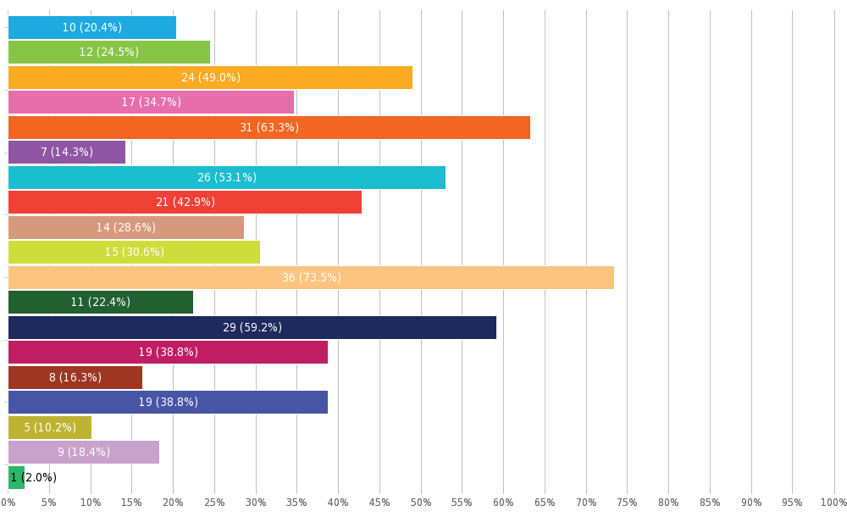
Which specialists have you consulted for NF care? 3/3

Slide 18
Who coordinates your NF medical care if multiple specialists are required? 1/2
Single choice, answers 49x, unanswered 3x
Answer Choices | Responses | Ratio
No one, I manage my/my child(ren's) NF medical care. | 24 | 48.98%
Family Doctor | 10 | 20.41%
Paediatrician | 5 | 10.2%
Neighbourhood Medical Clinic | 1 | 2.04%
Genetic Specialist | 1 | 2.04%
Other Specialists - please list | 6 | 12.24%
I haven't received any specialized care for my NF | 2 | 4.08%

Slide 19
Who coordinates your NF medical care if multiple specialists are required? 2/2

Slide 20
How often do you see a medical practitioner about NF? 1/2
Single choice, answers 49x, unanswered 3x
Answer Choices | Responses | Ratio
Once per month or more frequently | 7 | 14.29%
Several times per year | 20 | 40.82%
About once per year | 7 | 14.29%
Less than once or twice every five years | 2 | 4.08%
Not in the past five years | 2 | 4.08%
Rarely | 9 | 18.37%
Never | 2 | 4.08%

Slide 21
How often do you see a medical practitioner about NF? 2/2

Slide 22
Where do you receive your medical care? 1/2
Multiple choice, answers 49x, unanswered 3x
Answer Choices | Responses | Ratio
In my own community | 38 | 77.55%
Travel to major centre | 18 | 36.73%
Travel outside province | 1 | 2.04%
Travel outside Canada | 1 | 2.04%
Access online medical care within province | 2 | 4.08%
Access online medical care outside province |  | 0%
Access online medical care outside Canada |  | 0%
I do not receive medical care | 3 | 6.12%

Slide 23
Where do you receive your medical care? 2/2

Slide 24
On average, approximately how many hours per month do you spend managing NF care (including travel to and from appointments, speaking with specialists about medical and education issues related to NF, undertaking personal research)?
Single choice, answers 49x, unanswered 3x
Answer Choices | Responses | Ratio
Less than 2 hours/month | 32 | 65.31%
Less than 6 hours/month | 7 | 14.29%
Less than 10 hours/month | 5 | 10.2%
Less than 15 hours/month | 1 | 2.04%
More than 16 hours/month | 4 | 8.16%

Slide 25
How do you believe your health is most affected by NF? 1/3
Multiple choice, answers 49x, unanswered 3x
Answer Choices | Responses | Ratio
Bone Deformities | 8 | 16.33%
Bone Fragility | 4 | 8.16%
Deafness | 2 | 4.08%
Ependymoma | 1 | 2.04%
Facial Paralysis | 3 | 6.12%
Headaches | 21 | 42.86%
Hearing Loss | 2 | 4.08%
Hypertension | 4 | 8.16%
Internal Tumours | 29 | 59.18%
Itching | 22 | 44.9%
Learning Differences | 26 | 53.06%
Limb Loss |  | 0%

Slide 26
How do you believe your health is most affected by NF? 2/3
Meningiomas | 2 | 4.08%
Pain | 20 | 40.82%
Peripheral Nerve Tumour | 11 | 22.45%
Plexiform Tumours | 19 | 38.78%
Problems with Balance | 16 | 32.65%
Scoliosis | 12 | 24.49%
Seizures | 7 | 14.29%
Skin Tumours | 25 | 51.02%
Speech Difficulties | 18 | 36.73%
Spinal Core Compression | 6 | 12.24%
Schwannoma Tumours | 4 | 8.16%
Vision Loss | 12 | 24.49%
Other - please list | 7 | 14.29%

Slide 27
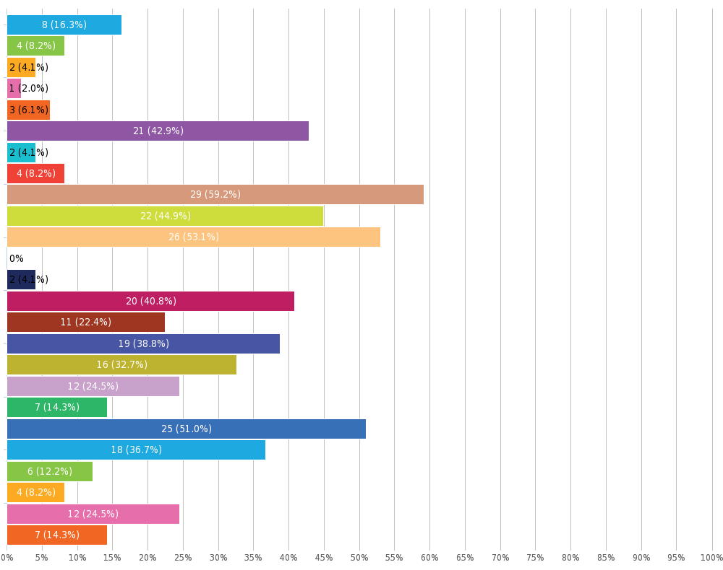
How do you believe your health is most affected by NF? 3/3

Slide 28
What types of care have you accessed in order to treat or manage your NF symptoms? 1/2
Multiple choice, answers 49x, unanswered 3x
Answer Choices | Responses | Ratio
Imaging (MRI, xray, etc.) | 43 | 87.76%
Surgery (please indicate for which symptoms in the "Other" answer) | 28 | 57.14%
Chemotherapy | 6 | 12.24%
Pharmaceuticals intended for pain management | 7 | 14.29%
Pharmaceuticals intended for management of NF symptoms | 4 | 8.16%
Pharmaceuticals intended to reduce tumour growth | 2 | 4.08%
Physical Therapy | 13 | 26.53%
Radiation Therapy | 1 | 2.04%
Speech Therapy | 18 | 36.73%
Other - please list | 29 | 59.18%

Slide 29
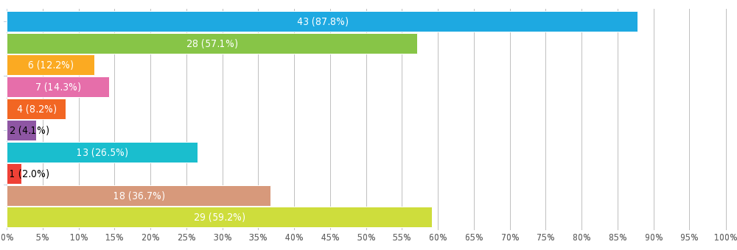
What types of care have you accessed in order to treat or manage your NF symptoms? 2/2

Slide 30
Have you participated in clinical trials or research studies for NF?
Single choice, answers 49x, unanswered 3x
Answer Choices | Responses | Ratio
No | 38 | 77.55%
Yes - please list the trials or studies you have been involved in. | 11 | 22.45%

Slide 31
Would you participate in a clinical trial if one was available to you?
Single choice, answers 49x, unanswered 3x
Answer Choices | Responses | Ratio
Yes | 32 | 65.31%
No | 2 | 4.08%
Maybe - add text to explain | 15 | 30.61%

Slide 32
What are your biggest challenges related to living with NF? 1/3
Multiple choice, answers 49x, unanswered 3x
Answer Choices | Responses | Ratio
Lack of professionals who understand the disorder | 29 | 59.18%
Lack of coordinated care | 24 | 48.98%
Lack of access to psychologist or counsellor | 8 | 16.33%
Lack of education supports for learning differences | 18 | 36.73%
Difficulties getting a job | 6 | 12.24%
Lack of information | 12 | 24.49%
Lack of family support | 4 | 8.16%
Lack of support from friends | 5 | 10.2%
Lack of public awareness | 32 | 65.31%
Social isolation/stigma | 17 | 34.69%
Depression | 18 | 36.73%
Anxiety of living with uncertainty | 25 | 51.02%

Slide 33
What are your biggest challenges related to living with NF? 2/3
Other - please describe | 10 | 20.41%
I don't have any challenges related to living with NF | 3 | 6.12%

Slide 34
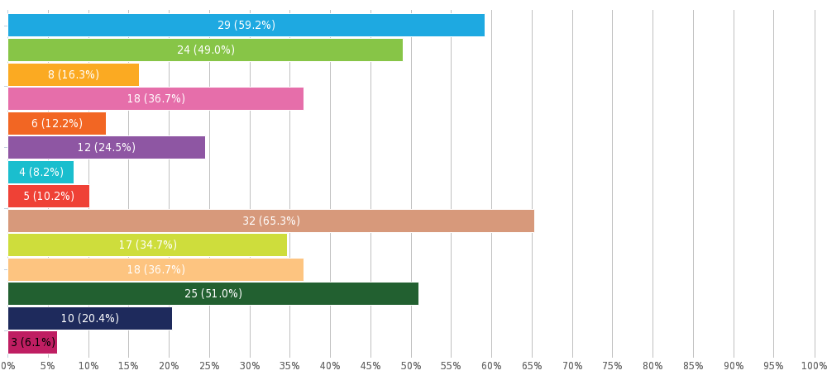
What are your biggest challenges related to living with NF? 3/3

Slide 35
How would you rate the medical care that you receive for NF related issues?
Matrix of single choices, answers 49x, unanswered 3x
 | Agree | Disagree | Undecided
Medical practitioners are knowledgable | 18 | 23 | 8
Medical appointments are available when needed | 20 | 19 | 10
Medical care is coordinated - providers share information | 20 | 23 | 6
Referrals to specialists are arranged when needed | 37 | 7 | 5
Requests for medical services (eg. MRIs) are arranged when needed | 35 | 5 | 9
Travel for care is convenient and affordable | 16 | 17 | 16

Slide 36
In what ways do you feel that you do not receive adequate medical care?
Text answer, answers 49x, unanswered 3x

Slide 37
How could your medical care be improved?
Text answer, answers 49x, unanswered 3x

Slide 38
Have you transitioned from paediatric care to adult care?
Single choice, answers 49x, unanswered 3x
Answer Choices | Responses | Ratio
Yes | 20 | 40.82%
No | 29 | 59.18%

Slide 39
How would you describe the impact of the transition from paediatric care to adult care on the quality of your care?
Text answer, answers 20x, unanswered 32x

Slide 40
If a Vancouver-based NF clinic existed, would you use the clinic?
Single choice, answers 49x, unanswered 3x
Answer Choices | Responses | Ratio
Yes | 44 | 89.8%
No | 5 | 10.2%

Slide 41
What might prevent you from using a Vancouver-based clinic?
Multiple choice, answers 49x, unanswered 3x
Answer Choices | Responses | Ratio
Cost of travel | 14 | 28.57%
Inconvenience of travel | 18 | 36.73%
Cost for accommodation | 9 | 18.37%
My doctor would not be there | 6 | 12.24%
Time off work | 15 | 30.61%
Other - please describe | 18 | 36.73%

Slide 42
If an NF clinic offered online appointments with specialists, what might prevent you from using this clinic?
Multiple choice, answers 49x, unanswered 3x
Answer Choices | Responses | Ratio
I don't have access to a computer or smart phone |  | 0%
I get overwhelmed learning new technology | 3 | 6.12%
I have security concerns of being online with my personal information | 2 | 4.08%
I prefer the personal connection of face to face with my doctor | 14 | 28.57%
Nothing would prevent me from accessing online services offerd by an NF clinic | 35 | 71.43%
Other - please list | 5 | 10.2%

Slide 43
*I accept the conditions of the contest and I confirm that I am aged 18 years or over.
Single choice, answers 49x, unanswered 3x
Answer Choices | Responses | Ratio
I accept | 47 | 95.92%
I do not accept | 2 | 4.08%

Slide 44
Full Name
Text answer, answers 50x, unanswered 2x

Slide 45
Email Address
Text answer, answers 52x, unanswered 0x

Slide 46
Phone Number
Text answer, answers 52x, unanswered 0x

Slide 47
Can we contact you to ask additional questions?
Single choice, answers 52x, unanswered 0x
Answer Choices | Responses | Ratio
Yes | 51 | 98.08%
No | 1 | 1.92%

