Slide 1

Supporting Students with NF1 in the Classroom
A Guide for Educators

Slide 2
What is Neurofibromatosis Type 1?
Genetic condition affecting ~1 in 2500 people
Inherited or spontaneous mutation in NF1 gene on chromosome 17
NF1
Causes tumours to form on nerves and can affect the skin, bones, and brain
Varies greatly between individuals (mild to significant symptoms)
Not contagious
No cure, but early intervention and symptom management can make a big difference!

Slide 3

Why is this Relevant to Educators?
50–60% of children with NF1 experience learning challenges
Common issues:
  ADHD
  Autism spectrum traits
  Speech delays
  Fine/gross motor difficulties
  Executive function challenges
With the right support, students
with NF1 can thrive in the classroom!
Notes:
Image: This Photo by Unknown Author is licensed under CC BY-ND

Slide 4


Learning & Behavioural Challenges
VISUAL
PERCEPTION
Visual Perception
What can educators do?
Difficulty processing visual information in the classroom
  Reading maps
  Understanding graphics
  Copying notes from a blackboard
Use word blanks, highlights, and graph paper in homework
Encourage computer usage for written assignments
Seat the student closer to the board
Ensure learning material is well-spaced and not cluttered!
Notes:
Image on the left: This Photo by Unknown Author is licensed under CC BY
Image on the right: This Photo by Unknown Author is licensed under CC BY-NC-ND

Slide 5


Learning & Behavioural Challenges
LANGUAGE
Language
What can educators do?
Difficulty understanding speech, writing, and instructions
Trouble expressing themselves verbally and in writing
Use pictures, visual prompts, or actions
Play games that promote language understanding (i.e., iSpy)
Provide time and patience for
students struggling to respond!
Notes:
Image on the left: This Photo by Unknown Author is licensed under CC BY-NC
Image on the right: This Photo by Unknown Author is licensed under CC BY-SA-NC

Slide 6
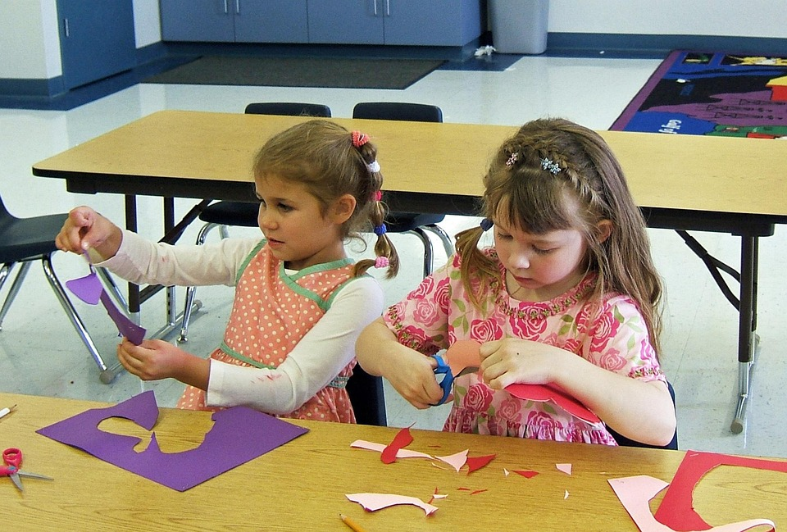
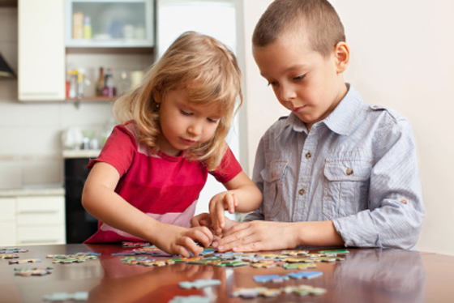
Learning & Behavioural Challenges
FINE MOTOR
Fine motor skills
What can educators do?
Difficulty controlling precise movements (i.e., writing)
Trouble in writing and drawing
Agree on the handwriting neatness expectation of student
Engage in activities that develop fine motor skills
  Making collages, puzzles, colouring
Negative statements such as “I hate drawing” can help identify what the child is struggling with.
Notes:
Image on the left: https://pixabay.com/photos/classroom-kindergarten-elementary-658002/
Image on the right: This Photo by Unknown Author is licensed under CC BY-SA-NC

Slide 7
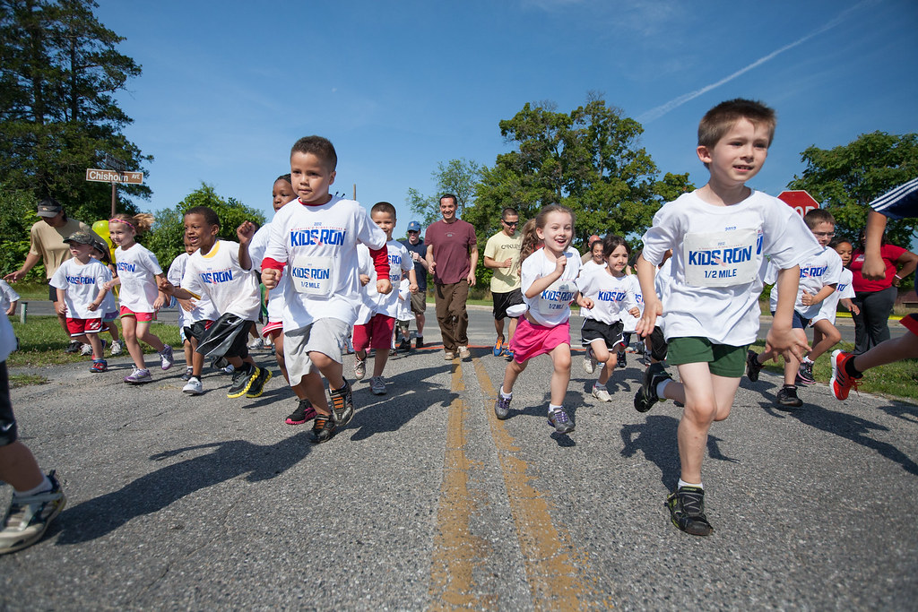
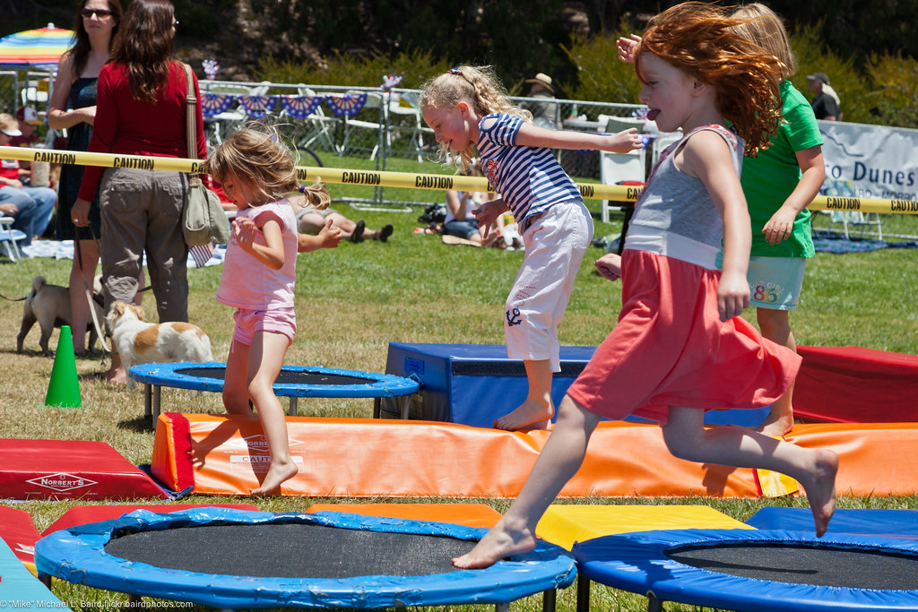
Learning & Behavioural Challenges
GROSS MOTOR
Gross motor skills
What can educators do?
Difficulty controlling large movements (i.e., walking)
Trouble in physical activities or sports
Focus on fitness, non-competitive activities, and repetitive motion sports
  Swimming, track, trampolines
Students can struggle with both fine and gross motor skills.
Notes:
Image on the left: This Photo by Unknown Author is licensed under CC BY
Image on the right: This Photo by Unknown Author is licensed under CC BY

Slide 8

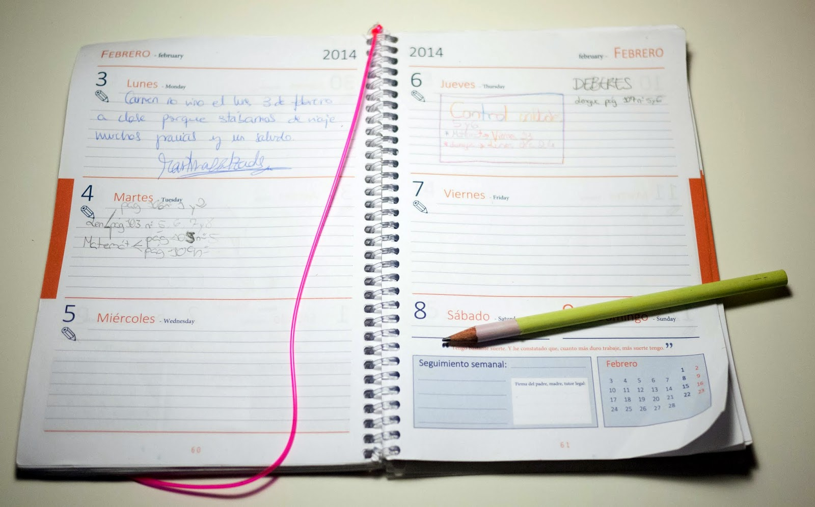
Learning & Behavioural Challenges
EXECUTIVE FUNCTION
Executive function
What can educators do?
Trouble organizing/processing information, time, and behaviour when approaching tasks
Can impact the student’s grades independent of their skill level
Create schedules using calendars or agendas
Provide extra support in organization (aids or peer tutors)
Fade support after skills are well-accomplished!
Notes:
Image on the left: Necesidades Especiales en Educación. : El rol del profesor.
Image on the right: This Photo by Unknown Author is licensed under CC BY

Slide 9
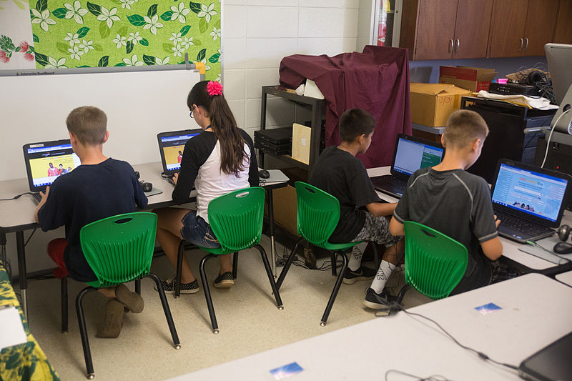
Learning & Behavioural Challenges
ATTENTION/ BEHAVIOUR
Attention and Behaviour
What can educators do?
ADHD and ASD is common
Students with ADHD may be:
  Inattentive (easily distracted)
  Hyperactive (restless/fidgety)
  Impulsive (acting without thinking)
Students with ASD may have:
  Problems with flexibility and social awareness
Give short, clear instructions
Allow movement breaks
Offer extended time for tasks/tests
Be understanding and adjust the workload to the student.
Notes:
Image: This Photo by Unknown Author is licensed under CC BY

Slide 10
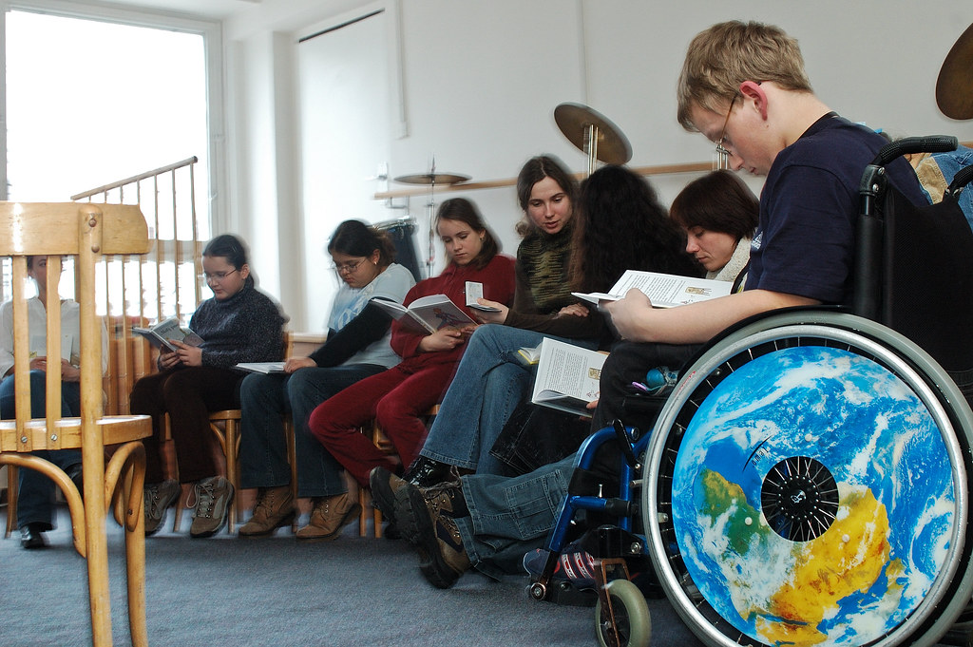

Learning & Behavioural Challenges
SOCIAL SKILLS
Social skills
What can educators do?
Struggles with social interaction and communication
Possible delay of language development
Can impact the student’s ability to form friendships
Plan playdates or activities with suitable peers
  Prepare the student
  Plan the activity with the student
  Ask for feedback
Encourage companionship!
Notes:
Image on the left: This Photo by Unknown Author is licensed under CC BY-NC-ND
Image on the right: https://www.rawpixel.com/image/148123/premium-photo-image-boys-bubble-bubble-wand

Slide 11

Individualized Supports and Educational Plans
If available, Individualized Educational Plan (IEP)
  Informal accommodations can be used if no official designation exists
Details of student’s strengths & weaknesses
Outline of measurable goals & strategies to achieve the goals
IEP
Specific area where the student needs help
Who (educator, student, parents) will do what by when and why
Communication with parents is essential to create well-aligned support strategies!

Slide 12

Social-Emotional Support for Students with NF1
Students with learning disorders can suffer from social isolation, poor self-esteem or difficulty making friends
Bullying awareness and prevention
Educate class on NF1 if granted consent by parents and student
Be aware of the student’s behavioural changes and communicate with parents
Focus on strengths and celebrate growth.
Notes:
Image: This Photo by Unknown Author is licensed under CC BY-NC-ND

Slide 13
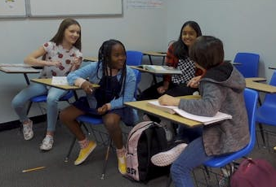
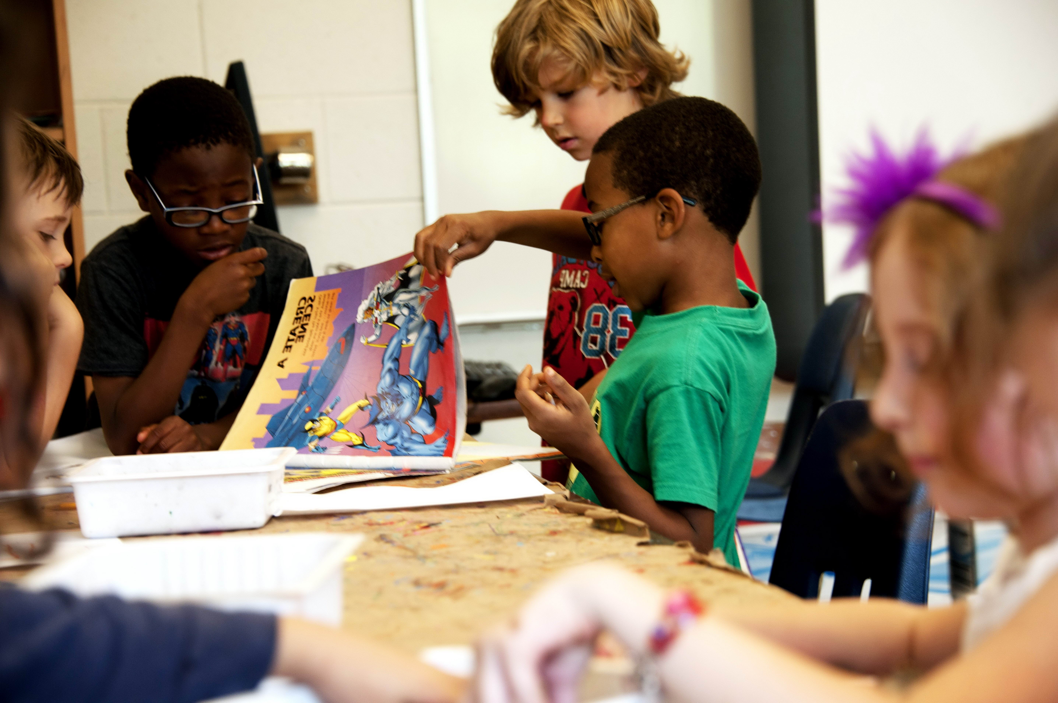
Social-Emotional Support for Students with NF1
Building confidence through effort-based praise
Students can become stuck in a “failure cycle” as they lose confidence
Reward based on effort and practice instead of outcomes
Reducing isolation through inclusive peer opportunities
Class discussions, team activities
Students with NF1 may face hidden challenges but can excel with encouragement and understanding!
Notes:
Image on the left: https://www.pexels.com/video/bullying-a-classmate-inside-the-classroom-6935503/
Image on the right: This Photo by Unknown Author is licensed under CC BY

Slide 14
Resources for Educators and Families
Many organizations are dedicated to improve the lives of people with NF1
Websites
Tumour Foundation of BC
Children’s Tumor Foundation
Nerve Tumours UK
Printable Guides
A Parent’s Resource Guide
Learning with NF1
NF1- A Guide for Educators
Supporting Students with NF1
Additional Notes for Teachers
Communities
NF Families Facebook Group
Reddit (r/neurofibromatosis)
All underlined resources are hyperlinked. Ctrl + click to follow the link!

Slide 15
Thank You for
Making a Difference!
Your support creates a classroom where every child can thrive. Thank you for being an ally in this journey.
Contact us at:
info@tumourfoundation.ca 1-800-385-2263 Facebook Instagram Twitter
19172 Fourth Avenue PO Vancouver, B.C V6K 4R8 Canada

